Slide 1
How to make a simple Skill Tree in Unity 3D
Guide to Using the SkillTreeComponent

Slide 2
Files
This script is a self-contained, modular component to be added to any gameobject type of your choice. In the example project we use a Sprite Renderer on a GameObject.
The script uses a simple trick to change the visual state of the Nodes and Links by switching child objects on and off (active/inactive)
Unity 3D Example Project (Link)
C# Skill Tree Component Script (Link)

Slide 3
Overview
SkillTreeComponents is a fun, adaptable Unity3D script for creating interactive skill trees in your game projects. It's designed with an intuitive, event-based system that tracks and updates the status of individual nodes (skills), making it a breeze to customize skill progression and create dynamic, engaging player experiences.

Slide 4
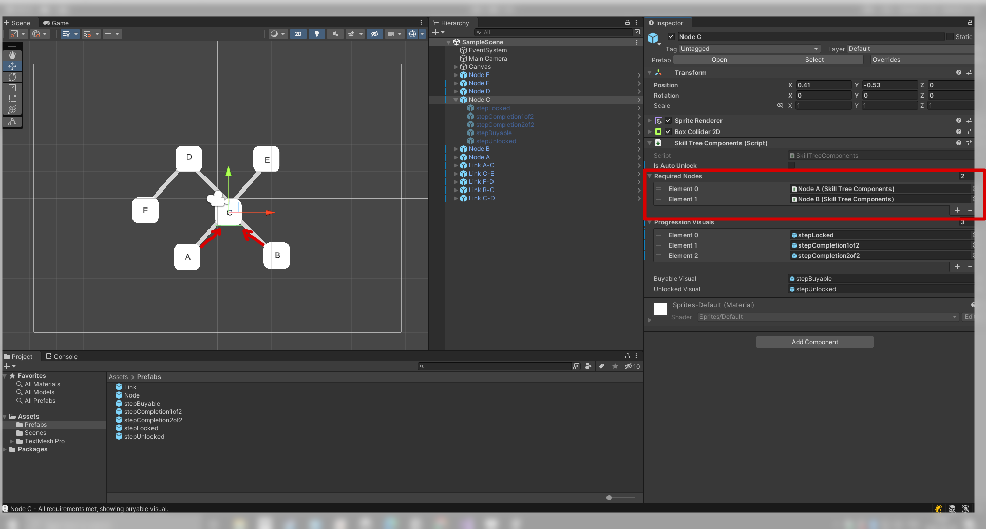
What It Does
Handles Node Dependencies: Nodes can require other nodes to be unlocked before they become available. This is great for creating complex, branching skill trees!

Slide 5
What It Does
Manages Visual Indicators: The script provides a flexible system for showing different visual elements based on a node's state. This can be used for tooltips, icons, or any other UI elements you dream up!

Slide 6
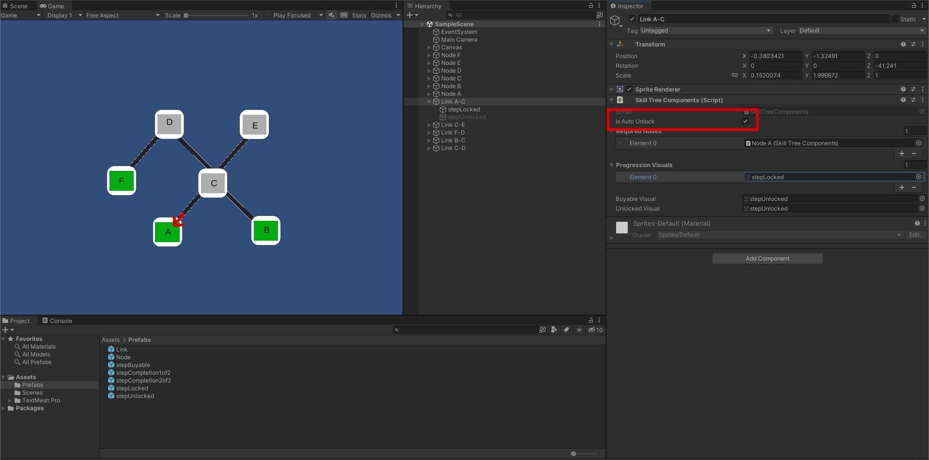
What It Does
Auto-Unlocks Nodes: The "auto-unlock" feature lets nodes automatically unlock when their requirements are met, skipping the usual purchasing step and shaking up the player's progression. Perfect for Links between nodes

Slide 7
How To Use It
Set up your GameObject: Attach the SkillTreeComponent script to a GameObject that represents a node or link in your skill tree.
Reference Required Nodes: If your node or link should require others to be unlocked first, add these to the 'Required Nodes' list in the Inspector.
Assign Progression Visuals: In the Inspector, add GameObjects to the 'Progression Visuals' list. These will represent the different states of your node starting with “locked”. For instance these game objects could contain the step by step images of a progress bar.
Set Buyable and Unlocked Visuals: Assign GameObjects to 'Buyable Visual' and 'Unlocked Visual'. These will be shown when the node is buyable or has been unlocked.

Slide 8
Break it , Fix it, Learn it, Hack it, Master it
Remember, this script is just a starting point. Feel free to hack, tweak, and expand it to suit your game's unique needs. Happy coding, and may your players delight in the skill trees you cultivate!

